Slide 1
德芷

Slide 2
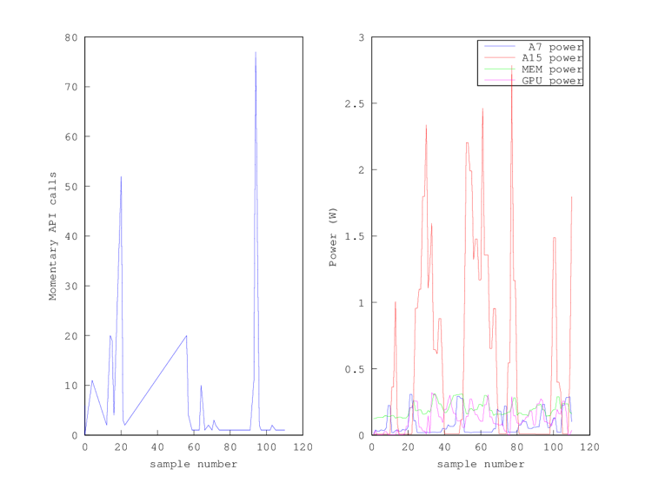
What is the critical problem for mobile today?

Slide 3
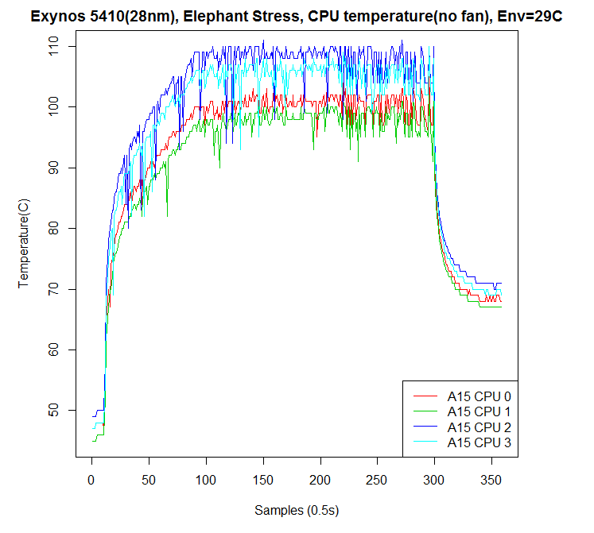
What is the critical problem for mobile today?

Slide 4
What is the critical problem for mobile today?
Long-distance running
How far a processor can run within a period under throttling
Sprint running
How long a processor can run at the maximal speed before throttling
Power budget allocation and job assignment

Slide 5
Our problems
How does Android schedule multi-core CPUs (big.little)?
Is thermal throttling serious? What kind of applications may suffer the problem?
Is there any better scheduling algorithm?
How to define better?
User feels better (better QoE)
Less power consumption/lower temperature (high temperature also leads high power consumption )
How about GPU loading, temperature? Does it influence CPU temperature or CPU scheduler? (floorplan aware)
How about cellular loading, temperature? Does it influence CPU temperature or CPU scheduler? (floorplan aware)

Slide 6
Goals
Study Android scheduler
Evaluate the performance (QoE), power and thermal under different benchmarks (real APPs or well-known benchmarks)
Propose our own solutions (thermal aware scheduler)
Demonstrate we can achieve the same performance (QoE) but less power consumption

Slide 7
Step 1: setup hardware/software environment
Find a hardware platform for experiment
Performance measurement tool
Power measurement tool
Thermal measurement tool (optional)
Reuse lab devices or your own devices (order if necessary)
ODROID
Identify suitable benchmarks and monkey programs
http://www.antutu.com/en/Ranking.shtml
Identify performance measurement tools
Setup software package and environment
Run and measure
APP QoE performance
APP power (GPU power and CPU power)

Slide 8
Step 2: understand Android scheduler
Trace Android/Linux multi-core (bit.little) scheduler code
Present your findings and experimental results
For example, when does Linux switch big and little core, switching overhead, …

Slide 9
Step 3: propose solution and evaluate the performance
Floorplan-aware (GPU loading aware, cellular loading aware)

Slide 10
Paper or competition
Thermal aware scheduler for Android devices
Demonstrate we can achieve the same QoE with less power consumption (lower temperatures)

Slide 11
Working model
Rudy/Eddie will provide more detail references to start with
Hardware environment?
Biweekly meeting with Rudy/Eddie (Charles will join the meeting monthly)
Problems you suffered
Share interesting findings with each other

